Slide 1









HPW Leadership Case Study
Senior Leaders’ Perceptions of the National Standard for Psychological Health and Safety at Work
Academy of Management
August 7, 2023
Notes:
Employee Mental Illness, Interpersonal Discrimination at Work, and how Human Resources can Help
Presenter Symposium (10575)
Academy of Management
August 7, 2023

Slide 2

Presentation
Outline
Introduction
Overview
Research objectives
Methods
Findings and discussion

Slide 3



Co-authors
Amanda J. Hancock
Kara A. Arnold
Ivy L. Bourgeault
University of Regina
Amanda.Hancock@uregina.ca
Memorial University
ArnoldK@mun.ca
University of Ottawa
Ivy.bourgeault@uottawa.ca

Slide 4
What is ‘The Standard’?
The National Standard of Canada for Psychological Health and Safety in the Workplace
A best practice document that offers guidance to employers and unions on how to identify, assess, eliminate, and control psychological hazards, and how to foster and promote psychological health and safety in the workplace (Pang, 2013).

Slide 5
Psychologically healthy and safe workplace
A workplace that:
…“actively works to prevent harm to worker psychological health, including in negligent, reckless, or intentional ways, and promotes psychological well- being.” (Pang, 2013, p. 4)
Notes:
Standard’s definition of psychologically healthy and safe workplace

Slide 6

What is ‘The Standard’?
  Commissioned by the Mental Health Commission of Canada.
  Funded by Canadian government, Great West Life, and Bell Canada.
  Developed by the CSA and BNQ.
  Released in 2013 (75 pages, 14 sections) and reaffirmed in 2018.
  (BNA/CSQ Group MHCC, 2013)

Slide 7



The Standard
Voluntary
Effective
First
Notes:
On effectiveness - Sheikh et al. (2018)

Slide 8




Research Objectives
To understand leaders’ perceptions about
The Standard…
Mental Health
Leaders
Varied Familiarity
Change
Organizational leaders considered mental health experts.
Some participants involved with Standard development and implementation, others not.
Identify strengths and opportunities for improvement.
Intersectional Gender Based Analysis: Identity, Roles & Norms
Notes:
Understand leaders’ perceptions about the Standard
Hear from leaders with varying levels of familiarity with the Standard
Identify strengths and opportunities for improvement

Slide 9
Methods
Sample
Data collection
Analysis
Notes:
Sample: Qualitative data, leaders recognized as mental health experts at work
Data collection: 10 stakeholder interviews, 1 focus group, 3 webinars – 22 participants
Data analysis: Recorded on zoom, transcribed using Otter ai, reviewed for accuracy. Preliminary themes identified.

Slide 10
Leaders’ Perceptions of the Standard

Slide 11
Awareness
Varied between sectors. Participants from public sector and nonprofit organizations displayed higher levels of awareness about the Standard.

Slide 12
Content
Participants familiar with the standard identified potential areas for improvement such as the need to review the Standard using a gendered lens to make it more equity, diversity, and inclusion focused.

Slide 13
Quote Participant 9
[Our organization] is very interested in the Standard and also interested in the equity, diversity, and inclusion around the Standard….they could have done a better job than the Standard does around gender…but I’m also feeling around broader equity, diversity, racialized communities around all of that. And so, I think there’ s a big piece that, you know, could happen, that should happen with those different lenses.

Slide 14
Accessibility
Participants suspect the reason some organizations are apprehensive about Standard is due to misconceptions about degree of formality.
The Standard can be partially implemented and is in no way legally binding.
Notes:
‘Utilizing’ and ‘aligning’ preferred over ‘implementation’

Slide 15
Quote Participant 10
…organizations in Canada don’t want to say they’re implementing or adopting the Standard because they’re afraid there’s going to be some legal obligations, or they’re opening some can of worms…so I find a lot of organizations say they’re aligning with it or utilizing it as a framework to guide their efforts versus adopt and implement.

Slide 16
Quote Participant 8
…one of the easiest ways is simply to put the question to every policy, review, decision, strategy or planning meeting, change process, and/or transaction. That’s all. Just ask that question [about mental health implications], have a conversation and you can start to revolutionize the workplace

Slide 17
Support
Participants discussed challenges faced in obtaining early support for Standard from top management.
Participants felt greater resistance than for wellness initiatives focused on physical health.

Slide 18
Quote Participant 5
…and she said, “Oh yeah, okay, well let’s do it as a pilot project.” And I said, “When we walked in here did you see the [building under renovation]…it’s being renovated because there’s a physical threat to the employees that work in that building because of asbestos.” I said, “what’s the difference? Is that a pilot project, or is it a phased project with a commitment to eliminate that physical threat in the workplace?”. And she said, “I get it”.

Slide 19
Resources
Interventions should be focused on leadership and employees. Effective return-to-work planning and support for accommodations are important organizational resources.
Go beyond employee and family assistance programs to provide opportunities for emotional connection inside the organization through conversation (e.g., training, resource sharing, team meetings, campaigns).

Slide 20
Quote Participant 8
(RTW Planning)
The first question is – what is it you need to be able to go to work, do a good job, and leave at the end of the day with energy leftover? Because if you don’t have energy leftover, then your personal life, your personal relationships, and your home life are going to suffer. So, what is it you need? Second question is – what are you willing to commit to, to support your own success, and to support your own well-being at work?

Slide 21
Quote Participant 8d
(Beyond EFAP)
[Our organization] has a button campaign called ‘not myself today’. One of the buttons says ’zen’ and the other says ‘overwhelmed’. These buttons opened up the conversation about how people are feeling. Not about being soft, but having the conversation and reaching for the right tools. A simple but powerful action.

Slide 22
Discussion
  Two key opportunities for improvement:
    1) raise awareness outside of Canada and in private sector, and 2) review content for inclusiveness.
  The Standard is a promising and accessible resource for organizations looking to initiate or improve psychological well-being in the workplace in a manner that goes beyond traditional employee and family assistance programs.
  Even though the Standard was developed by national-level standards authorities, it is a voluntary, non-binding initiative that can be adopted in full or in-part. There are no plans to make it part of enforceable OHS legislation.
  Get your organization started by considering the mental health implications of every strategy, plan, action, decision, program, or policy on employees, managers, and stakeholders.

Slide 23
Thank You!
Key Take Home Message:
The Canadian Standard for Psychological Health and Safety at work is an evidence-based tool that has been available for a decade. It is effective and available free of charge for full or partial, non-binding adoption and implementation.
Questions or comments?
NAME: Amanda Hancock
EMAIL: Amanda.Hancock@uregina.ca
Notes:
So to reiterate our key take home message …

Slide 24

















Funding Acknowledgement
This work was supported by a Partnership Grant:
Healthy and Productive Work from the Social Sciences and Humanities Research Council (grant number 895-2008-4014)
Canadian Institute for Health Research
(grant number 2018-2024)
24

Slide 25
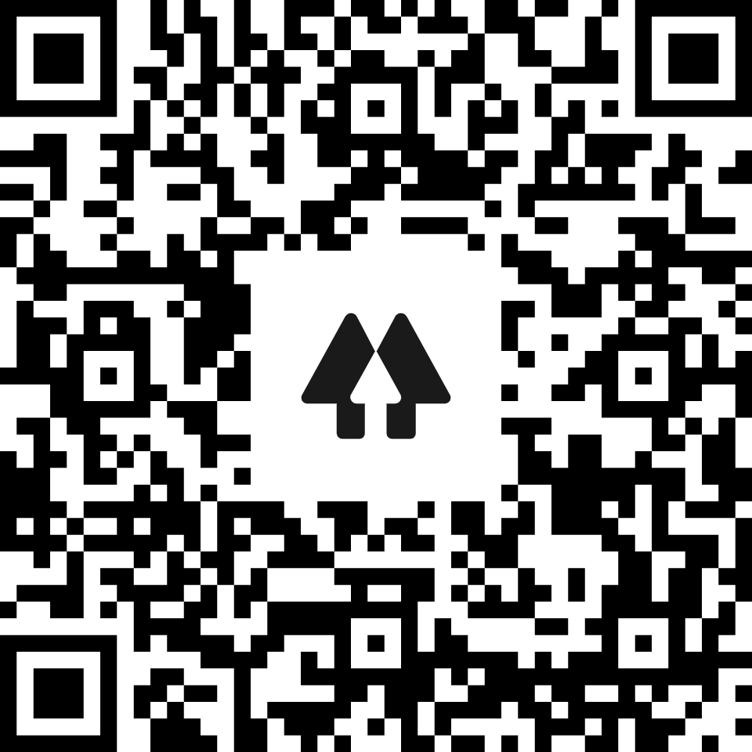





Connect with HPW on Social Media!
www.healthyprofwork.com
HPW@uOttawa.ca
@ProfHealthy
Healthy Professional
Worker Partnership
@ProfHealthy

Slide 26


For more information…
HPKW Project website:
  www.healthyprofwork.com
Emails:
  Amanda.Hancock@uregina.ca
  ArnoldK@mun.ca
  Ivy.bourgeault@uottawa.ca
Notes:
SSHRC
Grant name and information

Slide 27
References
BNA/CSQ Group MHCC (2013) National Standard of Canada: Psychological health and safety in the workplace – Implementation. CAN/CSA-Z1003-13/BNQ 9700-803/2013.
Pang, M. (2013, October 28). Current issues in mental health in
Canada: Psychological health and safety in the workplace (In Brief), Library of Parliament, Publication No. 2013-78-E.
Sheikh, M.S., Smail-Crevier, R., & Wang, J. (2018). A cross- sectional study of the awareness and implementation of the National Standard of Canada for Psychological Health and Safety in the Workplace in Canadian employers. The Canadian Journal of Psychiatry, 63(12), 842-850.

